Slide 1
Spokane River Revitalization Project

Slide 2
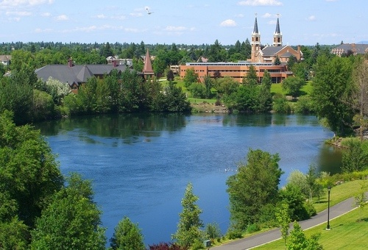
Groups
Biology
Ecology
GIS Mapping
Lake Arthur
Outreach

Slide 3
University District Ecological Alliance Mission Statement
Working collaboratively to ensure the ecological integrity, biodiversity, and resilience of a healthy Spokane River ecosystem.
Notes:
Spokane is built upon and centered around a river ecosystem that has largely been neglected and allowed to become unhealthy, losing its dignity as the symbol of our city. Each group has therefore looked to the University District Ecological Alliance Mission statement as means of guiding them in the right direction towards a better aquatic system. At the moment we are mainly focusing on the University District section of the river which lies between Trent Avenue and Green Street.

Slide 4
Biology

Slide 5
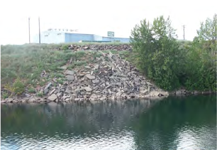
Current Biological Conditions
Urbanization
Railroads
Industries
Residences
Lack of buffer zones
Novel Ecosystem
Notes:
Urbanization presses right up to the banks in some areas, with railroads, industries, and residences bordering the river. This lack of natural space, or what we refer to as a "buffer zone", creates an unhealthy river ecosystem due to the fact that vegetation is needed to filter toxin runoff from urban areas before it reaches the river.
In some areas there are barren shores with no vegetation or suitable soil, while other areas have only small strips of land where the water can rise and fall by a few feet. This creates an unhealthy river ecosystem because seasonal fluctuation of river levels are necessary for soil erosion control.
Therefore by extending and restoring the riparian zone by promoting a healthy plant community, the aesthetics and health of the ecosystem will improve drastically.
The Spokane river is also what we refer to as a novel ecosystem. This means that due to historic industrialization or other human alterations, the river has become entirely unique, has no analogous systems, and holds both native and nonnative species. We recognize that returning the Spokane River to its previous state before human involvement is not achievable and thus, hope to create a healthier version of what we see today.

Slide 6
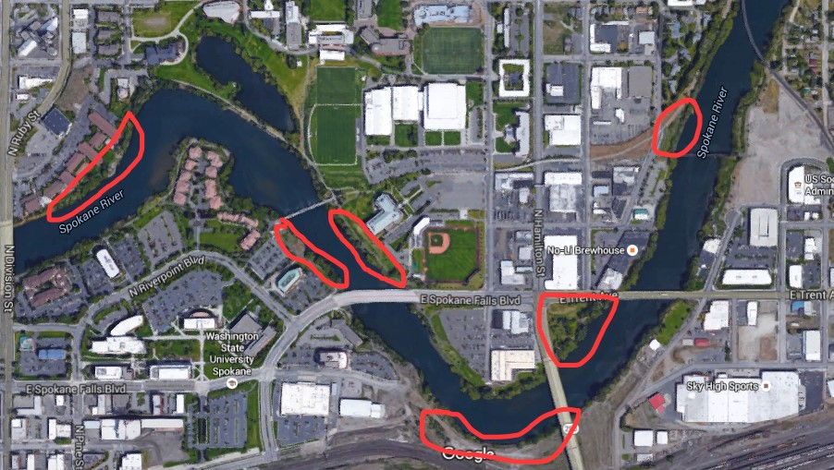
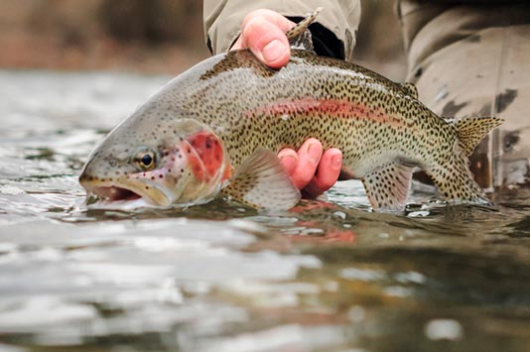
Short Term Goals
Increase vegetation => increase in filtration
Riparian planting grant
Locations
Student and community involvement
Redband trout mascot
Notes:
A healthy riparian zone will reduce current erosion and flooding, cool the warm water with shade, cycle important nutrients, promote human use, and promote wildlife. This is why our groups first goal is to plant more vegetation that is suitable for extensive toxic filtration around the river.
The Spokane Conservation District, who we are working closely with, has recently received a grant which will allow for us to begin the planting process. We are looking into various areas along the river (as depicted above) in order to deem which stretch is suitable for plant introduction. Once this area is designated, we hope to organize a day in which we can unite the Gonzaga and local community around our cause. We will have food and refreshments and will ask that volunteers devote an hour or two to planting predesignated species. The Lake Arthur group will further discuss which plant species we are looking into implementing.
We would also like to highlight flagship species and their importance, such as the redband trout, that the community can unite behind. The redband trout is an excellent option for this in that it is native to Spokane, many have fished or are familiar with it, it is an indicator species for a healthy ecosystem, and it is a beautiful fish.

Slide 7
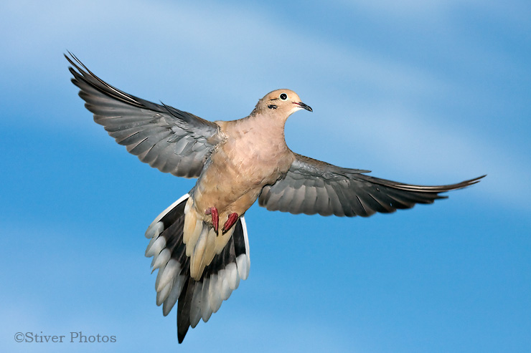
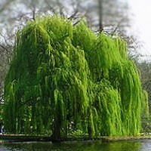
Long Term Management Plan
Interpretive signage
Species list
Keystone species
Invasive species
Native species
Nonnative non-harmful species
Notes:
In order to gain community support and involvement for this project, we recognize that the community first has to understand the problem. To achieve this, we want to implement interactive signage along the river that stresses the importance of large, functional riparian zones and the ecological services they can provide, what species are currently using this habitat, current problems with the river, and the feasible potential for restoring it.
Our goal of creating a healthier, novel, ecosystem does not rely solely on protecting native species while extirpating nonnative species, but rather looks at the impacts a given species has on its ecosystem. We therefore hope to compile a list of species that highlights positive or negative impacts they have on Spokane River's ecosystem. On this list we have begun to label keystone species, which play a major beneficial role in their community, invasive species, which are nonnative and harmful, and native species, which have originated in the area. We have also looked into nonnative non-harmful species that we are not concerned about extirpating.

Slide 8
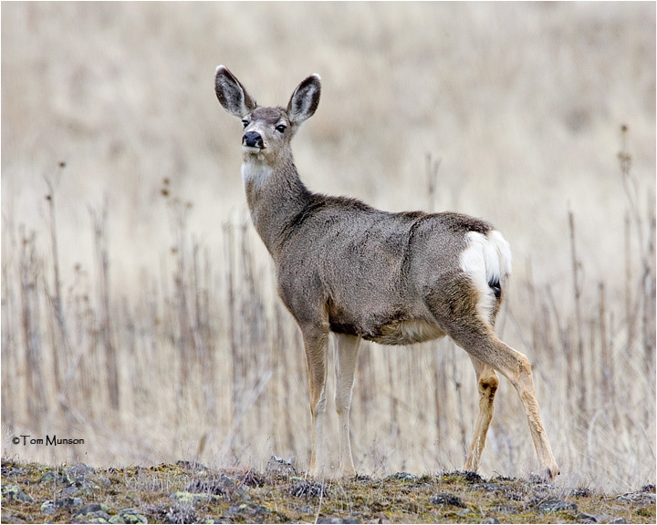
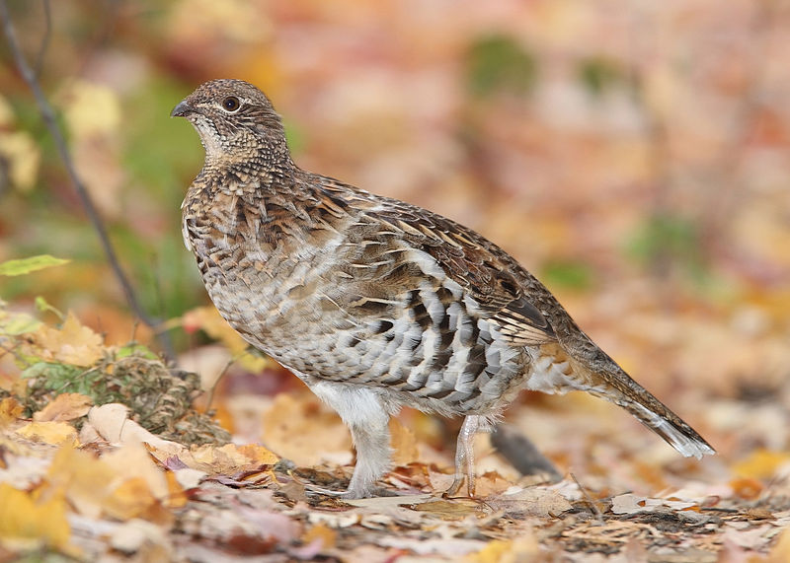
Long Term Management Plan
Restore Terrestrial Habitats
Canada geese
Mule deer
Ruffed grouse
Implementation
Identify potential areas
Concrete plan based on specific area
Fees
Restore aquatic habitats
Notes:
From this list we hope to begin the creation of a management plan that suppresses harmful species while promoting beneficial species. We found that the best way to start creating a healthier river ecosystem is by looking at terrestrial species along the river whose habitats have been negatively altered or destroyed by the Grand Coulee project. For example, the Canada goose nest sites, which were compromised during the construction of the Grand Coulee Dam, once provided nutrients to plant and aquatic life as well as breaks in the river’s fast paced flow. Therefore, in reestablishing these nesting sites, plant and aquatic life could once again flourish. We also hope to restore mule deer Habitat Units to address shrub-steppe and river break habitat losses as well as to restore ruffed grouse Habitat Units to address riparian/hardwood forest habitat losses. This can be accomplished first by identifying potential parcels for the mitigation process (which we have begun the process of as depicted previously), then by creating a concrete plan that establishes which plant life ought to be suppressed or enhanced, and finally by establishing a fee for anyone who damages these parcels. Once the terrestrial management plan is in effect, we hope to develop and implement projects directed at protecting, restoring, and enhancing fish habitat for both native and nonnative resident fish, through improvements in riparian conditions, fish passage, and aquatic conditions.
The plan is currently at a very primary stage and we are open to further suggestions pertaining to its implementation. We will not finish it, but hope to pass it on to future classes.

Slide 9
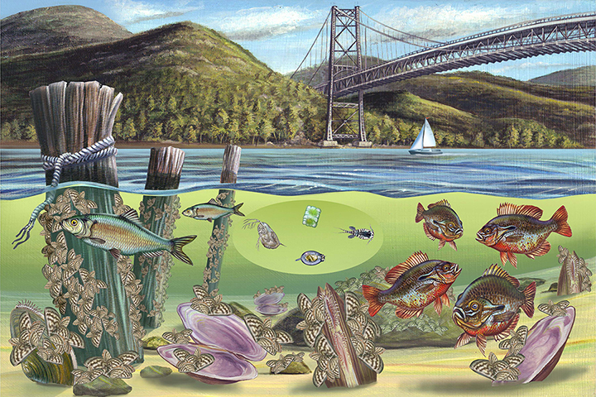
Ecology
Developing a rich ecological role within the Spokane River

Slide 10
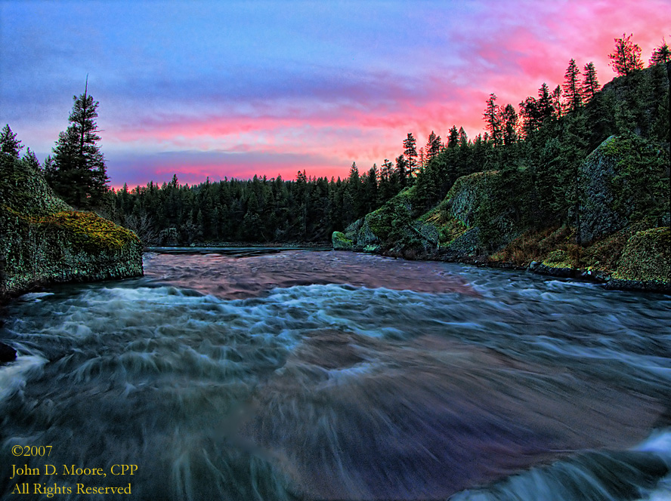
Our Focus:
Address ecological health of the Spokane River
Address human health issues and pollution
Monitor riparian zone
Vision for the River's ecosystem

Slide 11
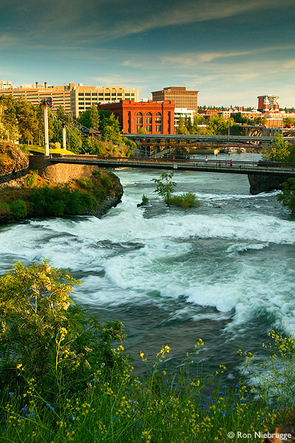
5 step monitoring plan:
Measure conductivity and alkalinity
Quantify pool habitats
Bank stability
Quantify debris
Identify dominant plant species

Slide 12
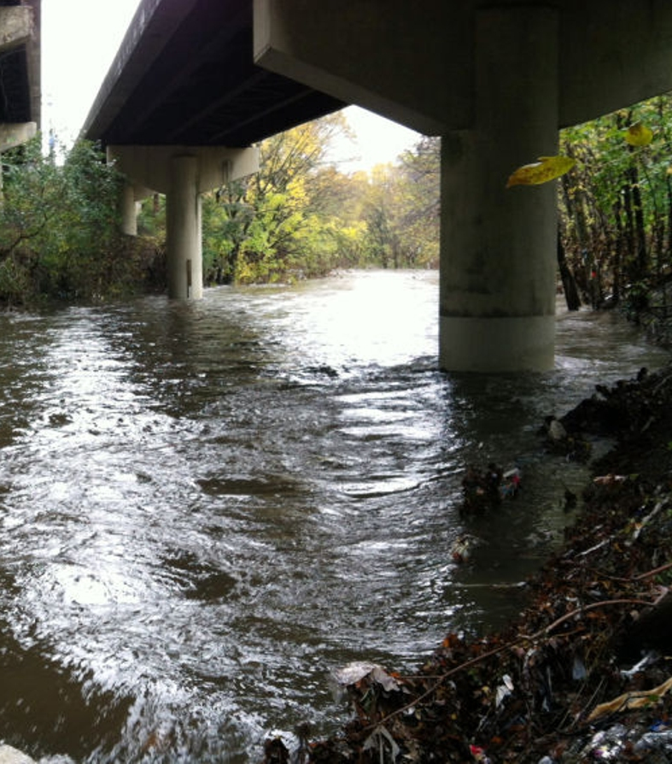
1. measure conductivity and alkalinity
Use hand-held conductivity meter, taking the reading near the surface in running water.
Recalibrate after each 8-day cycle testing.
Measure alkalinity at same time as conductivity.
Notes:
Using a hand held conductivity meter (taking the reading near the surface, in running water, and recording in ppm) once at each reach. Measure immediately upon arrival and before walking through the channel
Re-calibrate device after each 8 day cycle testing. Measure alkalinity at the same time as conductivity

Slide 13
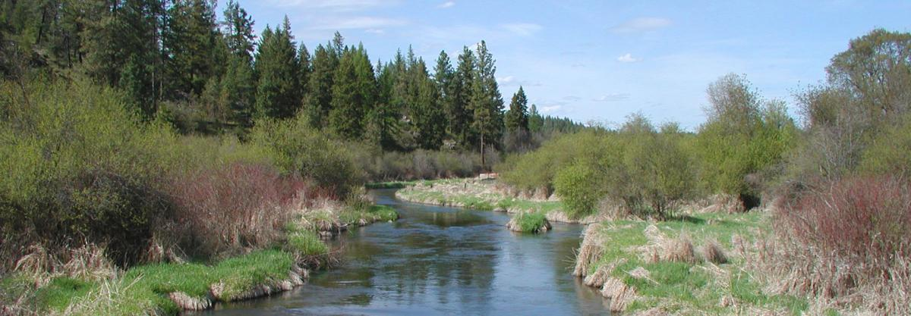
2. quantify pool habitats
Take relative pool length and determine relative depth.
Notes:
Taking relative length of pool and determine relating depth

Slide 14
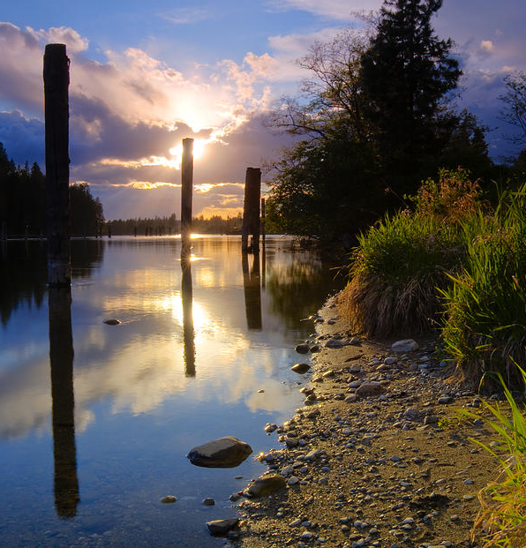
3. Bank stability
Determine relative stability by classifying plot in bank stability guidelines.
Notes:
The stability plot is 30 cm wide. The goal is to determine relative stability by classifying it as one of the following in the bank detail guidelines.

Slide 15
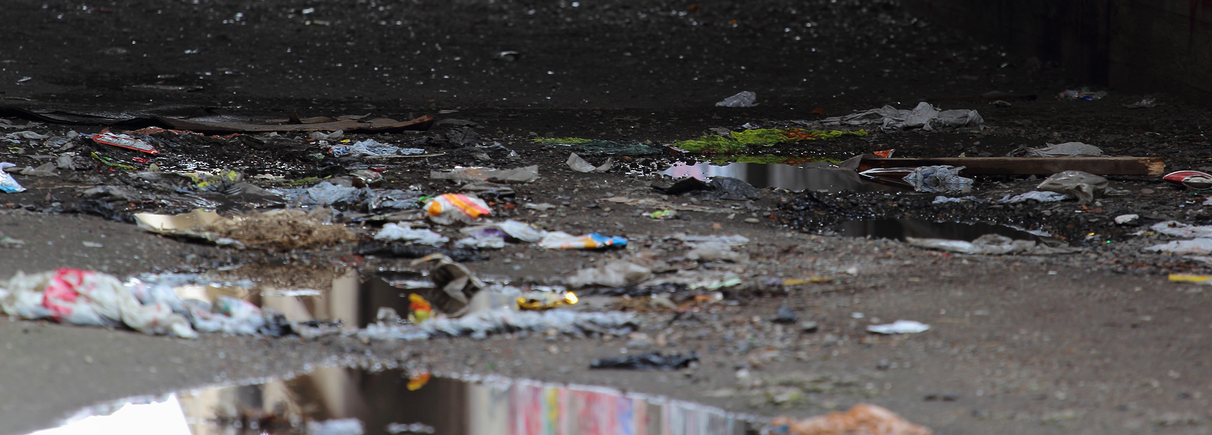
4. Quantify debris
Quantify natural debris and human caused debris listed in debris detail guidelines.
Notes:
Quantify number of natural debris as well as human caused debris (trash, etc.) listed in the debris detail guidelines.

Slide 16
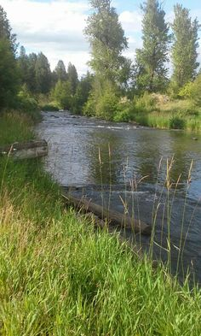
5. identify dominant plant species
Identify dominant plants using field book.
Notes:
identify dominant plant species using field book.

Slide 17
PCB's in Spokane River

Slide 18
What are PCb's
Polychlorinated biphenyl
Used for insulating capabilities/chemical stability
Unintended impacts, banned in 1979
Long lasting and bioaccumulate
Found in
Capacitors
Transformers
electrical equipment
sealants

Slide 19
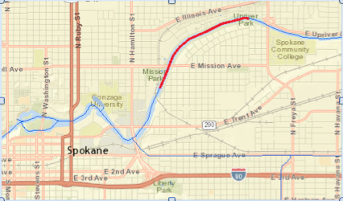
Current Status
Segments of the Spokane River violate the water quality standards for the presence of PCBs

Slide 20
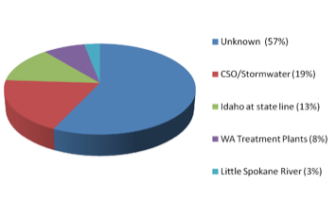
PCB Sources
Half of PCB source load is unknown
PCB loads are coming from storm water drainage into the river, groundwater sources, atmospheric sources, and upstream of the Idaho/Washington border
Also PCB load amounts coming from Washington Treatment plants

Slide 21
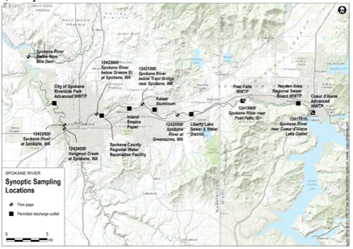
2014 Synoptic survey
August 2014
Department of Ecology
Measuring PCB's is challenging
Variability (concentrations/flow)
Uncertainty (blank samples)
Tiny (pictograms/liter)

Slide 22
2014 SYNOPTIC SURVEY
Washington State’s human health criteria for PCBs is 170 pg/l.
Spokane Tribe human health PCB water quality criterion of 3.37 pg/l
Numbers in red were determined to be outliers or oddities (are shown but not included when analyzing data).

Slide 23
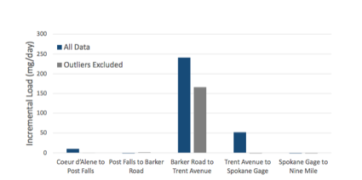
2014 SYNOPTIC SURVEY
Department of Ecology’s 2014 Synoptic Study, the greatest unknown load is occurring from Barker Road to Trent Avenue

Slide 24
Our Plan
Promote the ecological importance of the Spokane River
Teaming up with Spokane River Regional Toxics Task Force
Target particular areas to hopefully remove PCBs and or stop the discharge and point sources

Slide 25
GIS Mapping
Aiding the effort

Slide 27
GIS Research
Spokane County & City of Spokane GIS Databases
Data regarding:
Property boundaries and ownership status, as well as neighborhood boundaries
Access points
Urban Growth Plans
Local wetlands
Natural Resources Conservation Service (NRCS)
Data regarding:
Soil and water quality

Slide 28
GIS findings - Wetlands
Source: County Building and Planning

Slide 29
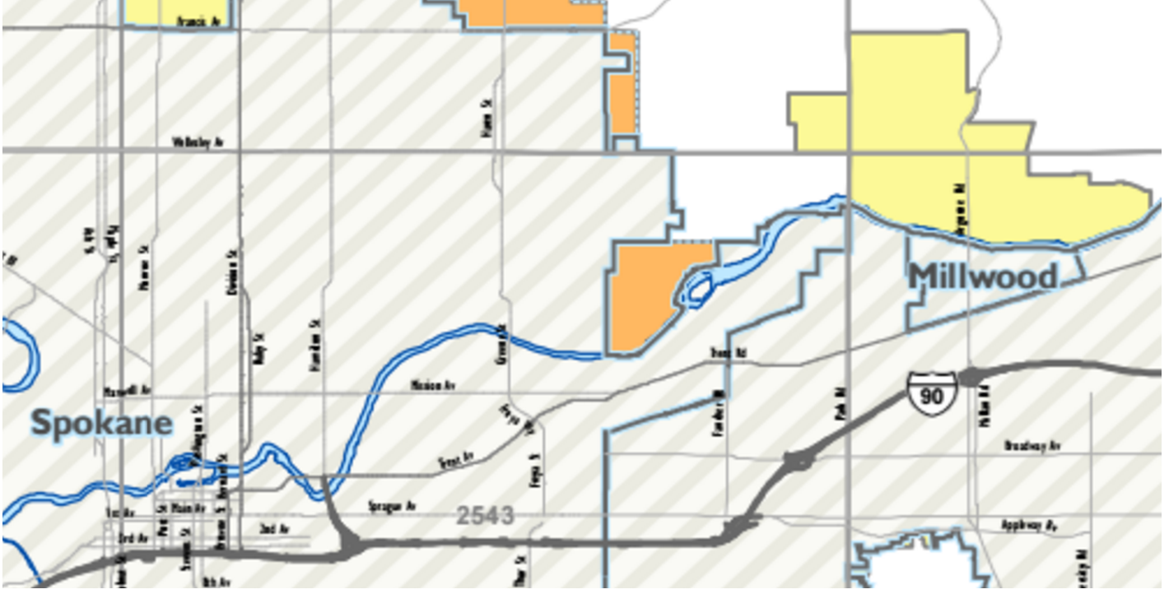
Gis findings – Urban Growth Areas
Source: Spokane County Department of Building and Planning

Slide 30
GIS FINDINGS – Riparian Areas
Riparian boundaries
None to be found!
Outlook
The UDEA wishes to outline current riparian zones using GIS. This will give us a starting point in the river restoration project.

Slide 31
GIS – Wildlife Corridors
Lets connect the black circles...
Legend
Red line: current corridors
Yellow hatched polygons: conservation areas
Created by: Dr. Kerry Books and Michael Bishop of Washington State University

Slide 32
Lake Arthur

Slide 33
Lake Arthur: An Ecological Stepping Stone

Slide 34
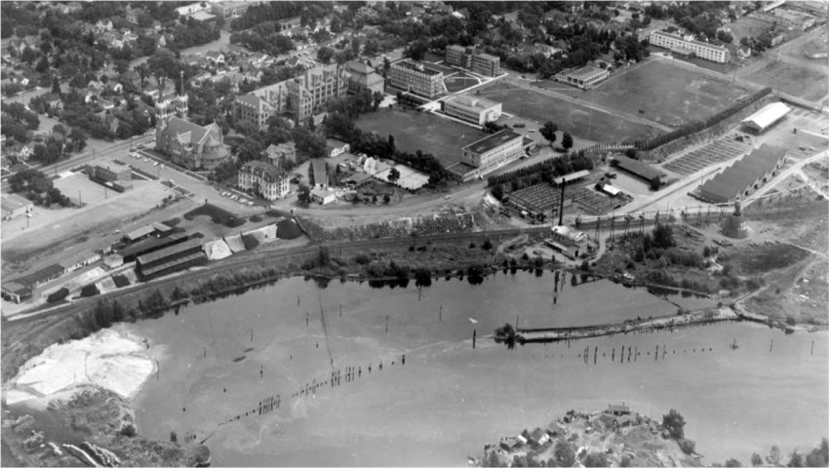

Slide 35
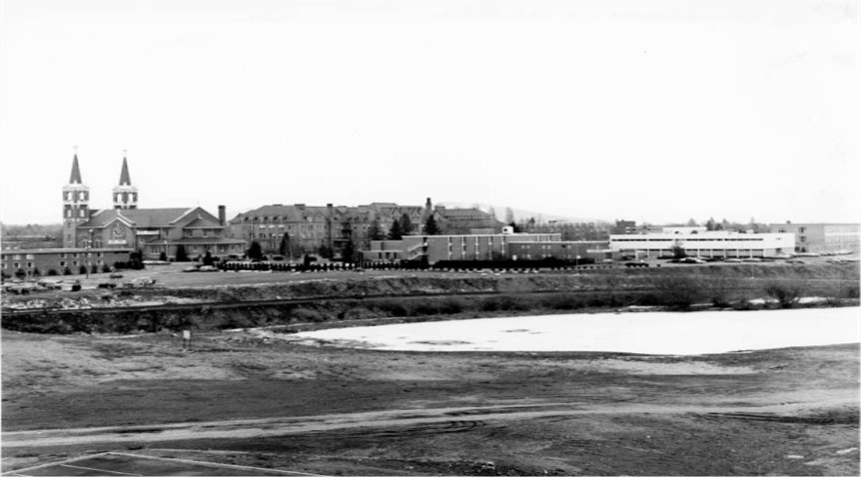

Slide 36
Background of the Problem
The Gonzaga community faces a threefold problem in regards to the state of Lake Arthur.
Lake Arthur is a potential resource for educational purposes for Gonzaga students of a multitude of majors and concentrations.
In the current ecological state of Lake Arthur, the ecosystem does not function adequately. We have the ability to invite various species of flora and fauna.
Finally, Lake Arthur's aesthetic qualities are subpar and we as Gonzaga students have a duty to restore the beauty to the lake.

Slide 37
Overarching Goals
We seek to enhance Lake Arthur to a fully functioning ecosystem that provides sanctuary for species of plants and animals as well as provide an educational resource for Gonzaga students.
In addition, we would like to enhance the lake's aesthetic integrity.

Slide 38
Phase 1: Short term goals
Increase vegetation/animal species
Ex. Cattails, willows, black birds, wood ducks
Create bio swale
Reduce nutrient levels due to runoff
Install a floating island
Provide habitat and bio filtration
Retract lawn line
Allows for larger wetland/riparian area
Raised walkway
Trash/recycling bins

Slide 39
Phase 2: Long Term Goals
Alter the slope surrounding the lake
Requires approval from various divisions
Shoreline Management Act
SEPA
Department of Ecology
City of Spokane
Future classes can evaluate the possibility of breaching
Reduce Canadian geese numbers

Slide 40
Benefits
Ecosystem Services
Environmental Education
Ecological Connectivity and functionality
Aesthetic integrity

Slide 41
Outreach
How do we bring access to the Spokane River to lower-income neighborhoods? Specifically within the Logan Neighborhood?

Slide 42
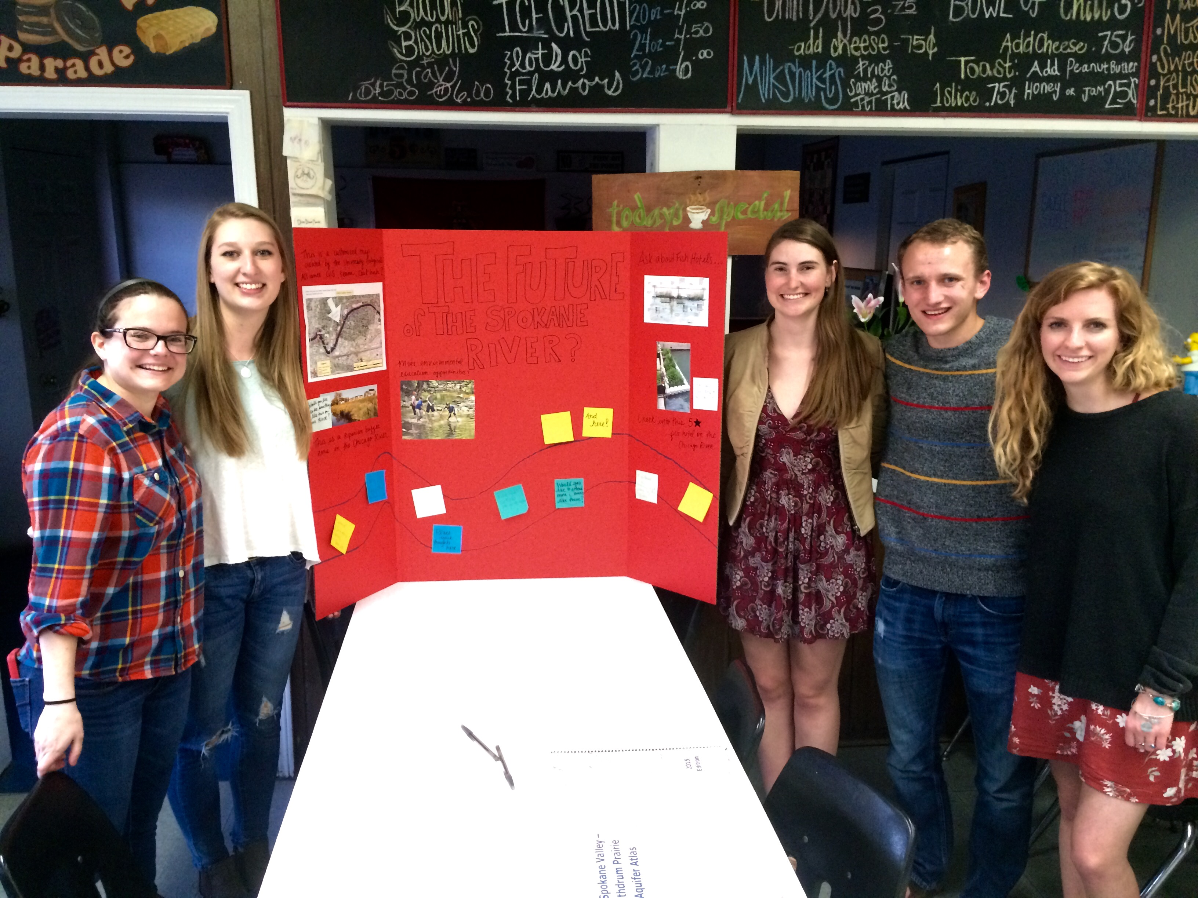
Our Concerns
Nature Deficit Disorder
No environmental education
No real access points
Gentrification
Addressing the homeless population without displacing them

Slide 43
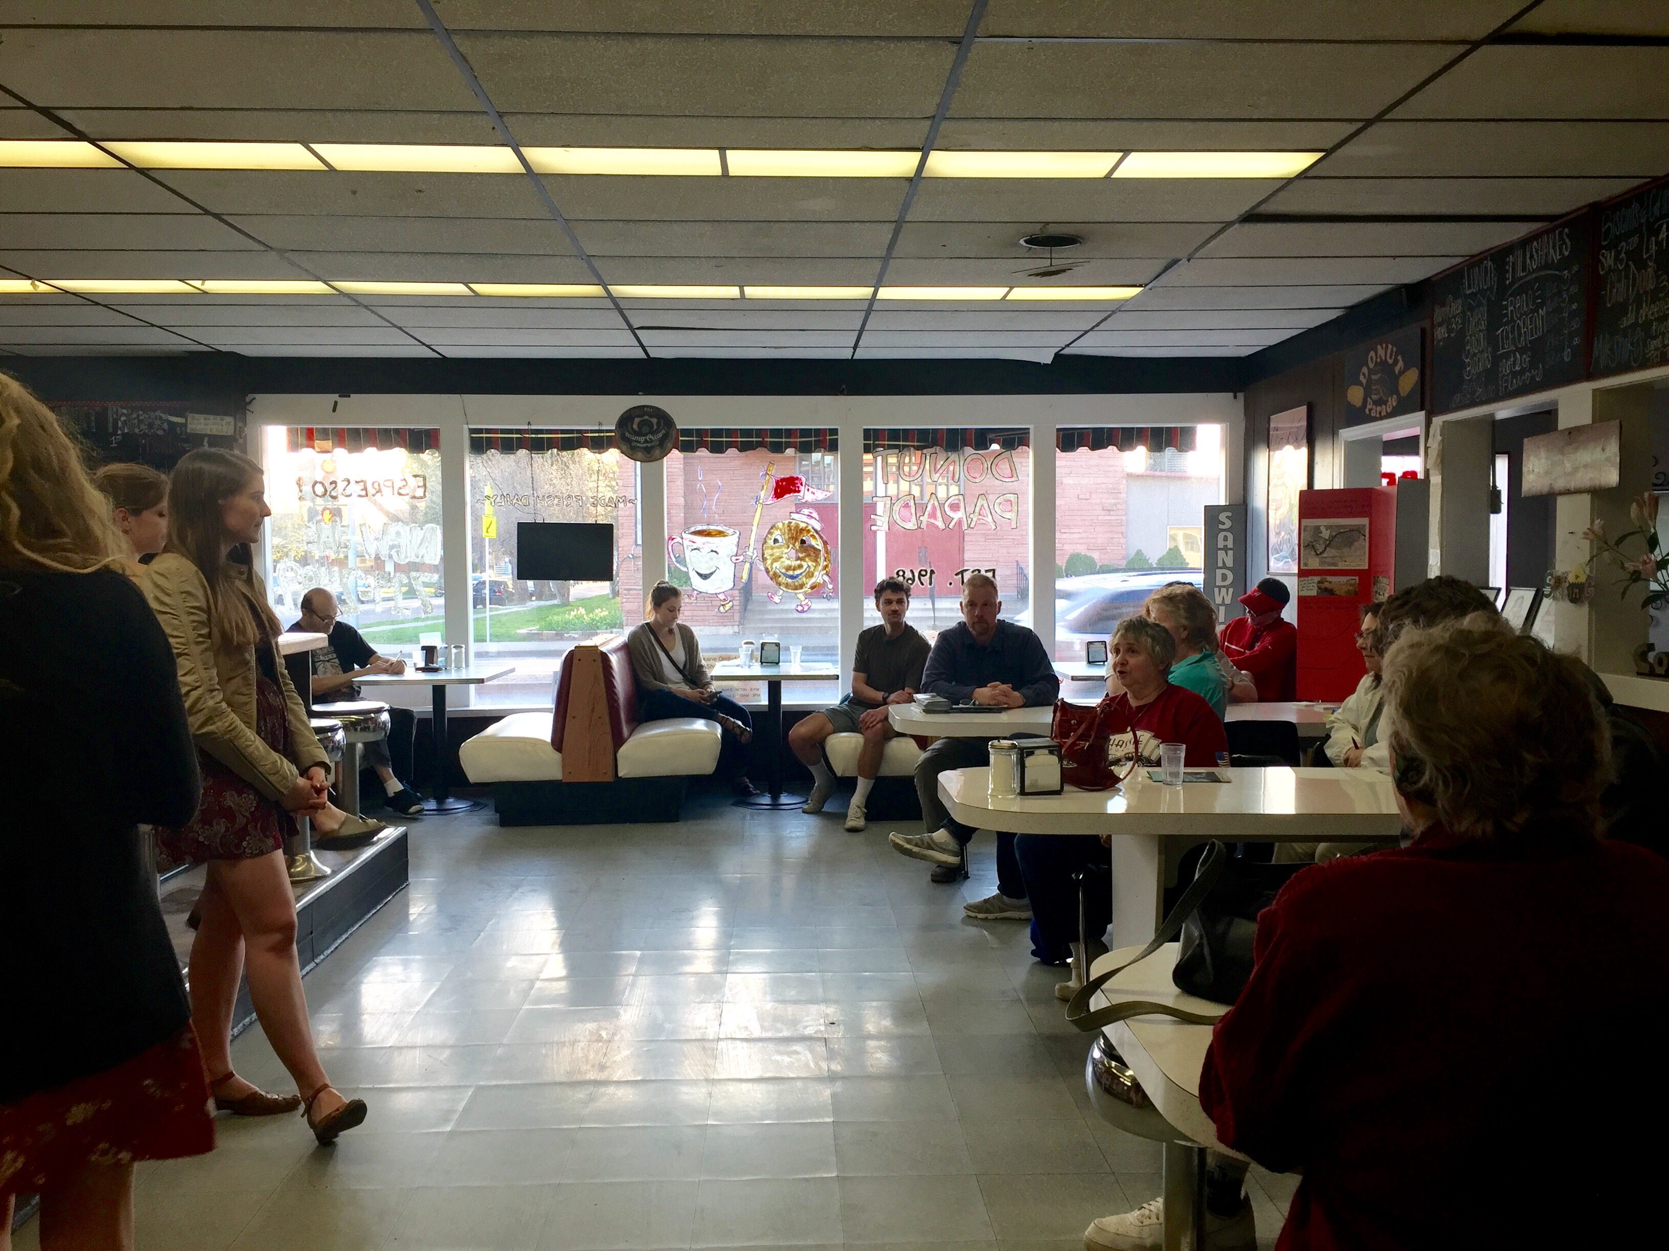
Community Concerns
Overall positive relationship BUT there is room for improvement
Improve safety
Remove noxious weeds and revegetate
Clean up litter along shoreline
Increase opportunities for environmental education
Establish an access point to increase recreation oppertunities

Slide 44
Identified Potential Access POints
Mission Park
Upriver Drive

Slide 45
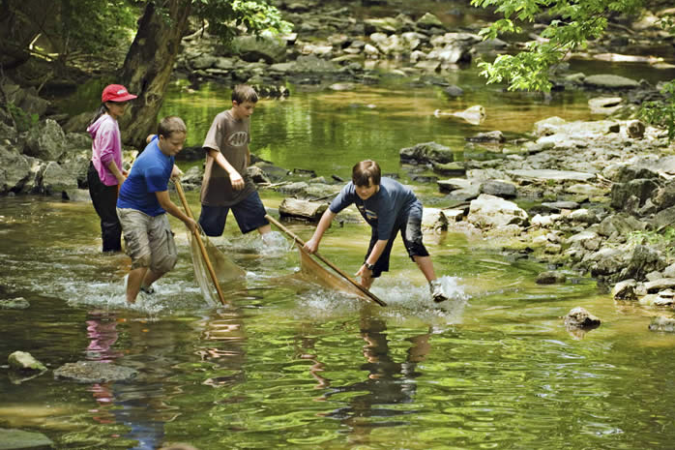
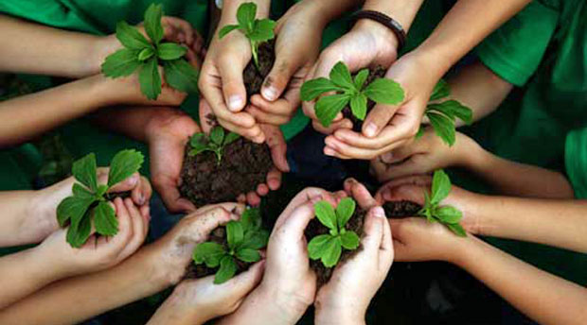
Implementation of Environmental Education Programs
Partner with Environmental Sustainability Education in Eastern WA
Implement after-school environmental education programs at the three different elementary schools in the Logan Neighborhood: Stevens, Logan, and St. Al's

Slide 46
Where do we go from here?
Host monthly community forums
Continued engagement from community partners and collaborators
Continued use of information platform to reach interested parties
Facebook page
Email List

